Slide 1


Hierarchical Clustering
Agglomerative vs Divisive Methods — An introduction to one of the most intuitive techniques in unsupervised machine learning, exploring how data points are organized into meaningful, nested groupings without predefined labels.
UNSUPERVISED LEARNING
DATA MINING
PATTERN RECOGNITION
Notes:
1

Slide 2

What Is Hierarchical Clustering?
Hierarchical clustering is an unsupervised machine learning technique that groups data points based on their similarity or distance — without requiring any predefined number of clusters. Unlike k-means, it builds a complete hierarchy of clusters, from individual points all the way up to a single group containing everything.
No Predefined k
Tree Structure
You don't need to decide how many clusters exist before running the algorithm.
Output is a nested hierarchy, visualized elegantly using a dendrogram.
Exploratory Power
Ideal for data mining, pattern recognition, and understanding data structure.
Notes:
2

Slide 3

Key Concepts
Before diving into the algorithms, it's essential to understand the foundational vocabulary that underpins hierarchical clustering.
Core Definitions
When to Use It
Distance metrics translate similarity into numbers. Hierarchical clustering excels in specific scenarios:
Cluster
A group of data points that are more similar to each other than to points outside the group.
Small to medium datasets — computationally intensive on large data
Exploratory analysis — when you don't know the cluster structure in advance
Pattern identification — uncovering natural groupings in data
Data segmentation — dividing populations into meaningful subgroups
Similarity
A measure of how close or alike two data points are in feature space.
Dissimilarity
Hierarchical clustering is especially powerful when you want to explore data at multiple levels of granularity simultaneously.
The opposite of similarity — quantifies how different two points are from each other.
Notes:
3

Slide 4






Distance Measures
The choice of distance metric directly shapes how similarity is computed — and therefore significantly affects clustering results. Different metrics suit different data types and problem contexts.
Euclidean Distance
Manhattan Distance
Minkowski Distance
The straight-line distance between two points in space.
Distance measured along axes at right angles — like navigating city blocks.
A generalized form that encompasses both Euclidean and Manhattan as special cases.
Most commonly used; works well for continuous, normalized data.
Preferred in high-dimensional spaces or when features are independent.
Parameter p controls the metric: p=1 (Manhattan), p=2 (Euclidean).
Notes:
4

Slide 5
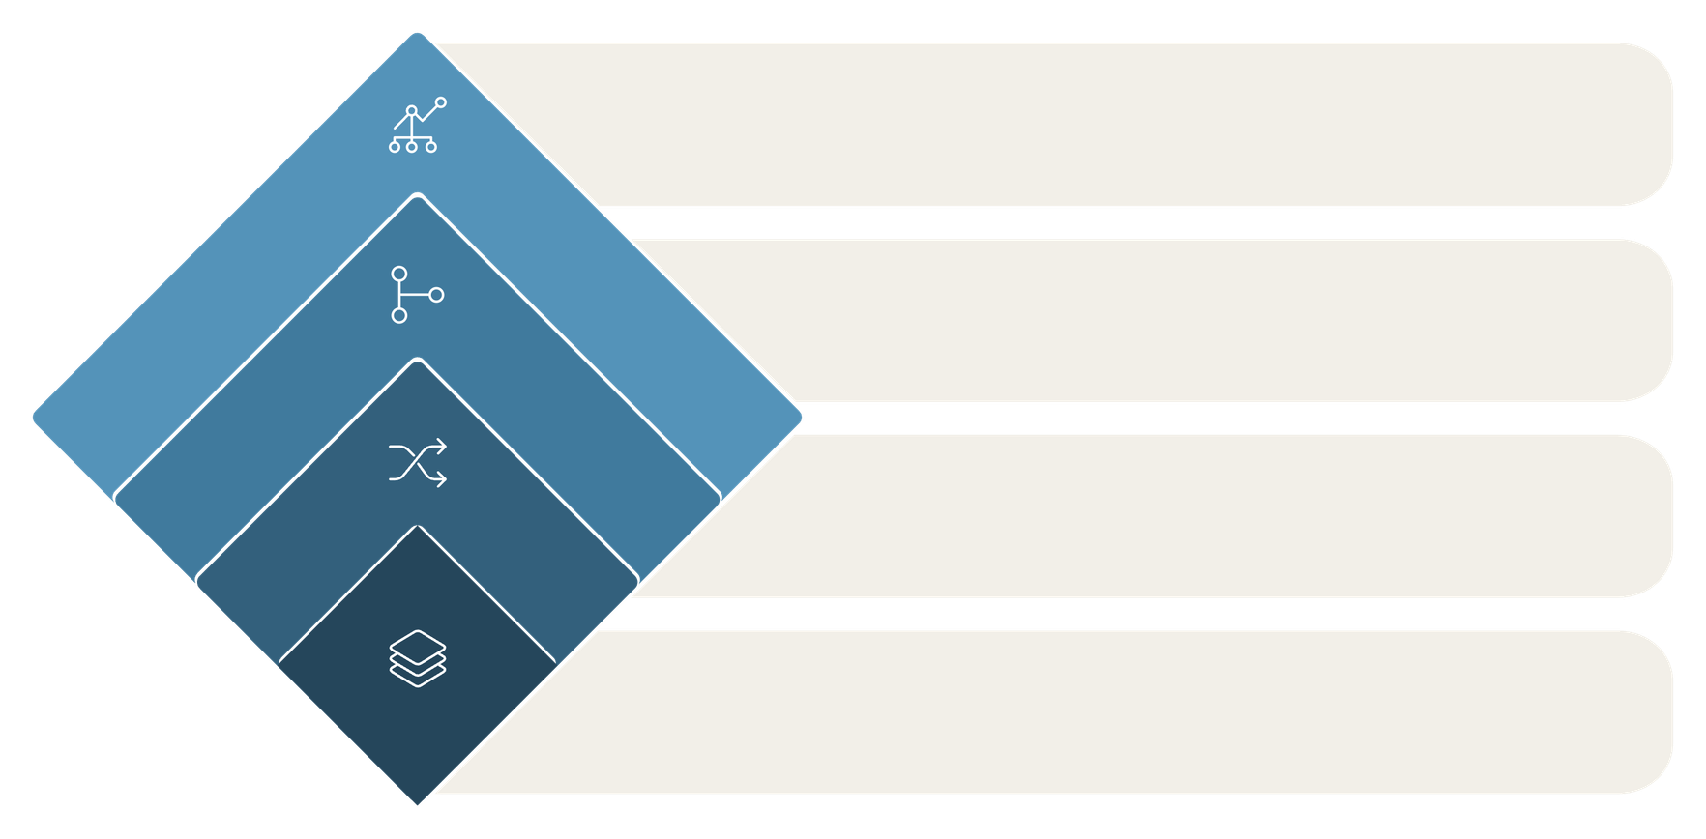




The Hierarchical Clustering Process
Hierarchical clustering builds its tree structure through a systematic, step-by-step approach. At each stage, the algorithm makes a locally optimal decision — merging or splitting clusters based on proximity.
Repeat & Visualize
Iterate until target and plot dendrogram
Merge or Split
Best merge or best split by linkage
Compute Distances
Pairwise distances using metric
Initialize
Start clusters: singletons or one
The algorithm follows a greedy approach — it makes the best decision at each step without backtracking. Once two clusters merge (or a cluster splits), that decision is permanent. The final output is a dendrogram that captures the entire hierarchy of decisions.
Notes:
5

Slide 6



The Dendrogram: Visualizing Clusters
A dendrogram is a tree-like diagram that records the sequence of merges or splits in hierarchical clustering. It is the primary tool for interpreting and communicating clustering results.
Leaves (Bottom)
Each leaf represents an individual data point in the dataset.
Branches
Each branch point marks where two clusters were merged (or one was split).
Height
The vertical height of a merge indicates the distance between the clusters — taller means more dissimilar.
💡 How to choose k: Draw a horizontal line across the dendrogram. The number of vertical lines it cuts equals the number of clusters.
Notes:
6

Slide 7




Agglomerative Clustering: Bottom-Up
MOST WIDELY USED METHOD
Agglomerative clustering starts with every data point as its own cluster and iteratively merges the closest pairs until a single cluster — or a desired number of clusters — remains. It is the most popular hierarchical approach due to its simplicity and effectiveness.
Compute Distances
Initialize
Calculate the distance between all pairs of clusters using the chosen linkage criterion.
Each of the n data points begins as its own individual cluster.
Repeat
Merge Closest
Continue until one cluster remains or the required number of clusters is formed.
Fuse the two most similar clusters into a single new cluster.
Example use case: Customer segmentation — grouping shoppers by purchasing behavior without knowing the segments in advance.
Notes:
7

Slide 8




Linkage Criteria
Linkage criteria define how the distance between two clusters is calculated. This choice has a major impact on the shape and structure of the resulting clusters — different linkage methods produce fundamentally different groupings.
Single Linkage
Complete Linkage
Uses the minimum distance between any two points in different clusters. Tends to produce elongated, chain-like clusters. Sensitive to noise.
Uses the maximum distance between points. Produces tighter, more compact clusters. Less sensitive to outliers.
Average Linkage
Centroid Linkage
Uses the average distance across all point pairs. A balanced compromise — widely used in practice.
Measures distance between cluster centroids. Can produce inversions in the dendrogram but is computationally efficient.
Notes:
8

Slide 9
Divisive Clustering & Computational Complexity
Divisive Clustering: Top-Down
Complexity & Limitations
The opposite of agglomerative — starts with all data points in one cluster and recursively splits them into smaller groups.
Agglomerative Complexity
Begins with a single cluster containing all points
Identifies the cluster to split (often using k-means with k=2)
Repeats until each point is its own cluster or a stopping criterion is met
O(n²) to O(n³) — manageable for small datasets, but becomes prohibitive as n grows.
Divisive Complexity
More computationally demanding and less commonly used in practice.
Exponential in the worst case — evaluating all possible splits is computationally infeasible for large data.
Key Limitations
Not suitable for large datasets. Sensitive to noise and outliers. No backtracking — early mistakes cannot be undone.
Notes:
9

Slide 10





Comparison, Applications & Conclusion
Agglomerative vs Divisive
Real-World Applications
Aspect
Agglomerative
Divisive
Bioinformatics
Customer Segmentation
Direction
Bottom-Up
Top-Down
Gene expression clustering and phylogenetic tree construction.
Grouping consumers by behavior for targeted marketing.
Approach
Merging
Splitting
Complexity
O(n²–n³)
Exponential
Document Classification
Image Segmentation
Usage
Widely used
Less common
Organizing text corpora into topic-based hierarchies.
Partitioning images into meaningful regions for computer vision.
Social Networks
Identifying communities and influence clusters within networks.
Key Takeaway: Hierarchical clustering builds multi-level, nested clusters without requiring a predefined k. The dendrogram enables intuitive visualization and informed decision-making. Agglomerative clustering remains the go-to method — balancing interpretability, flexibility, and practical performance across a wide range of data science applications.
Notes:
10

Slide 11
THANK YOU
BY : Jahanvi Srivastava(RA2311003011082)

